Slide 1
Algorithms
Lecture # 04
Dr. Sohail Aslam

Slide 2
Example – 2 dimension maxima

Slide 3
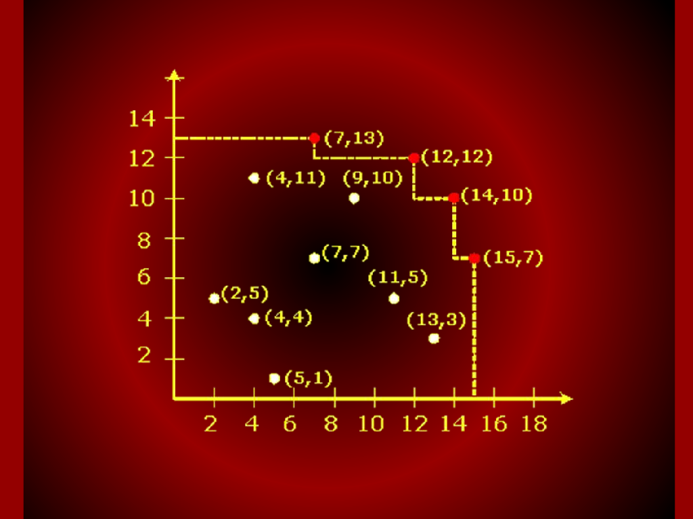
Graph

Slide 4
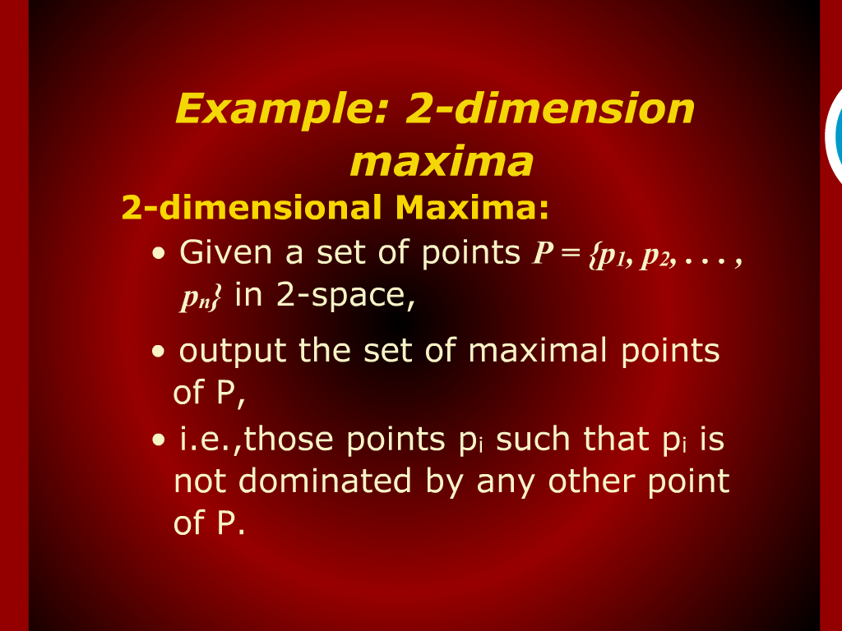
Example: 2-dimension maxima

Slide 5
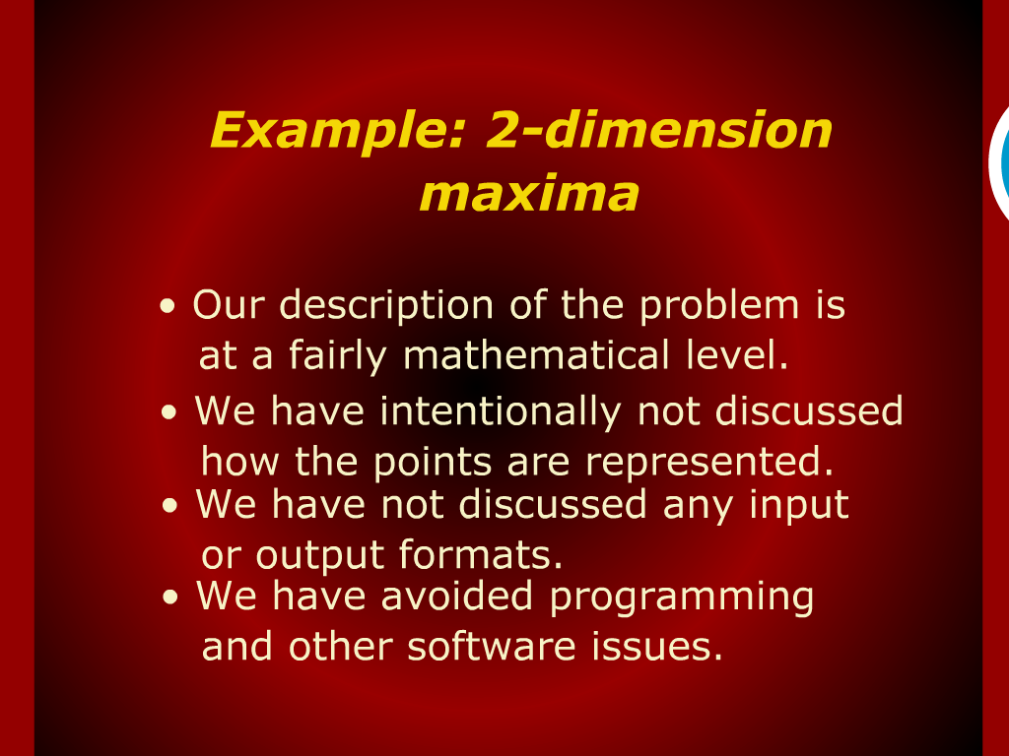
Example: 2-dimension maxima

Slide 6
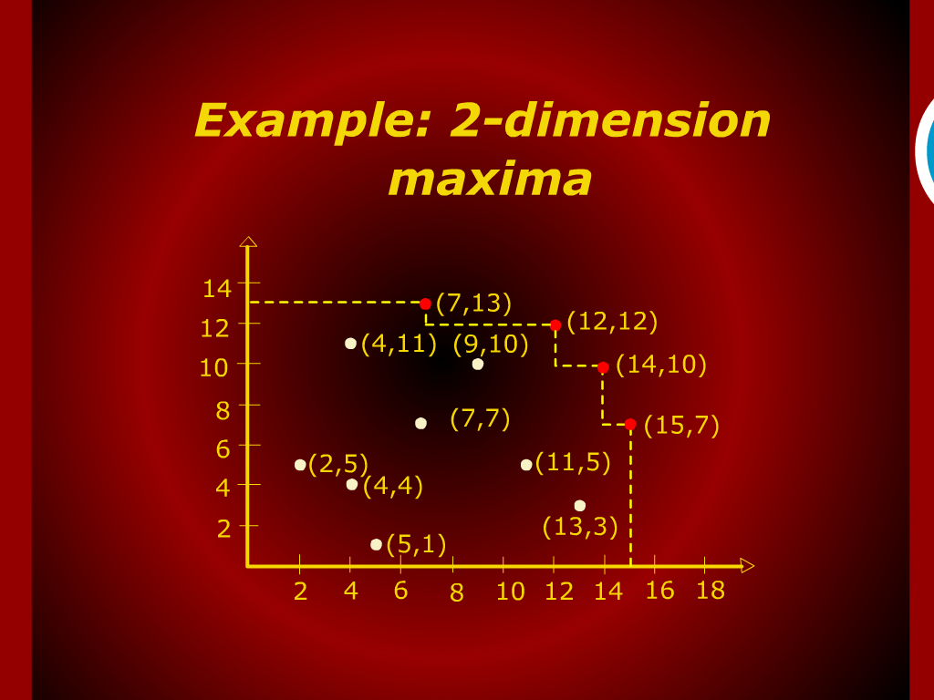
Example: 2-dimension maxima

Slide 7
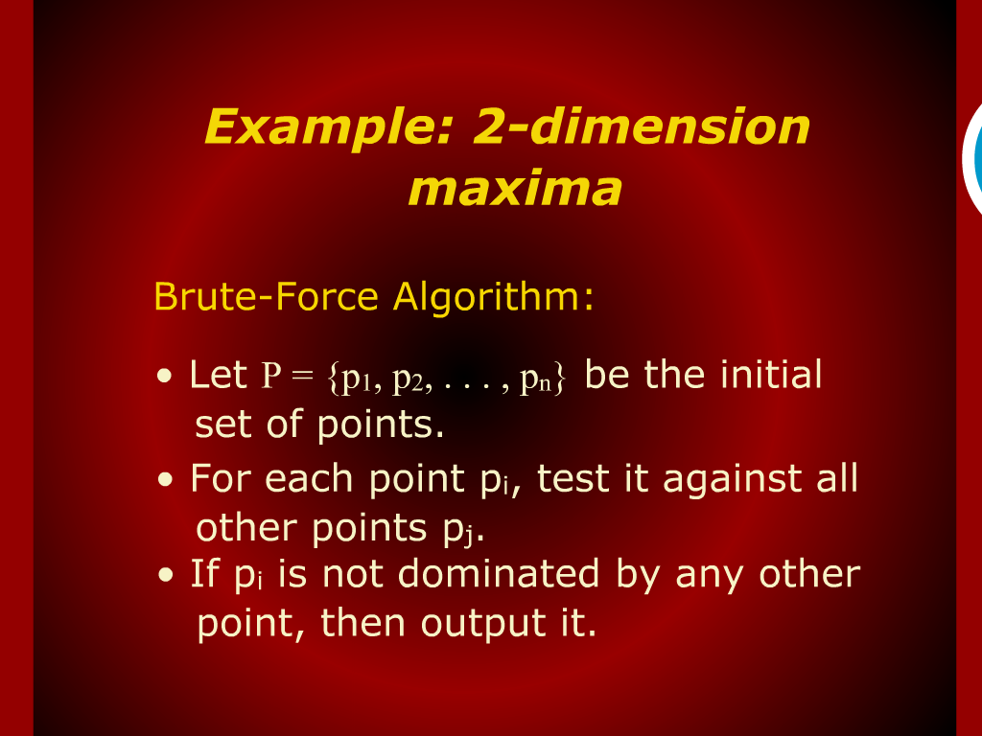
Example: 2-dimension maxima

Slide 8
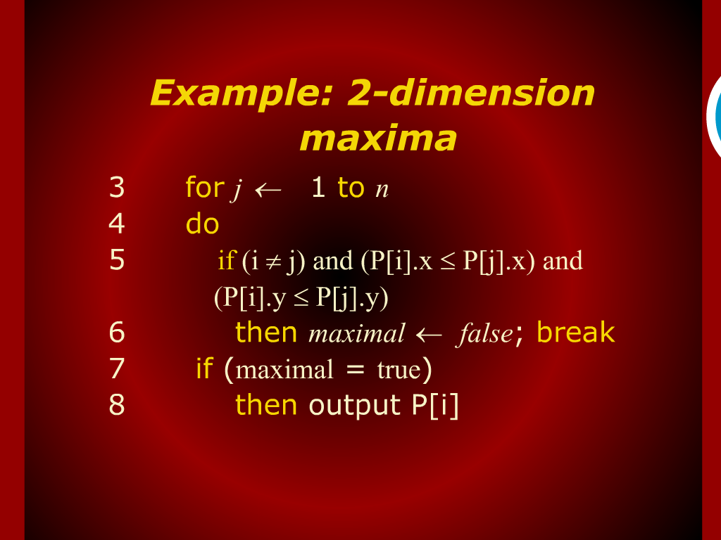
Example: 2-dimension maxima

Slide 9
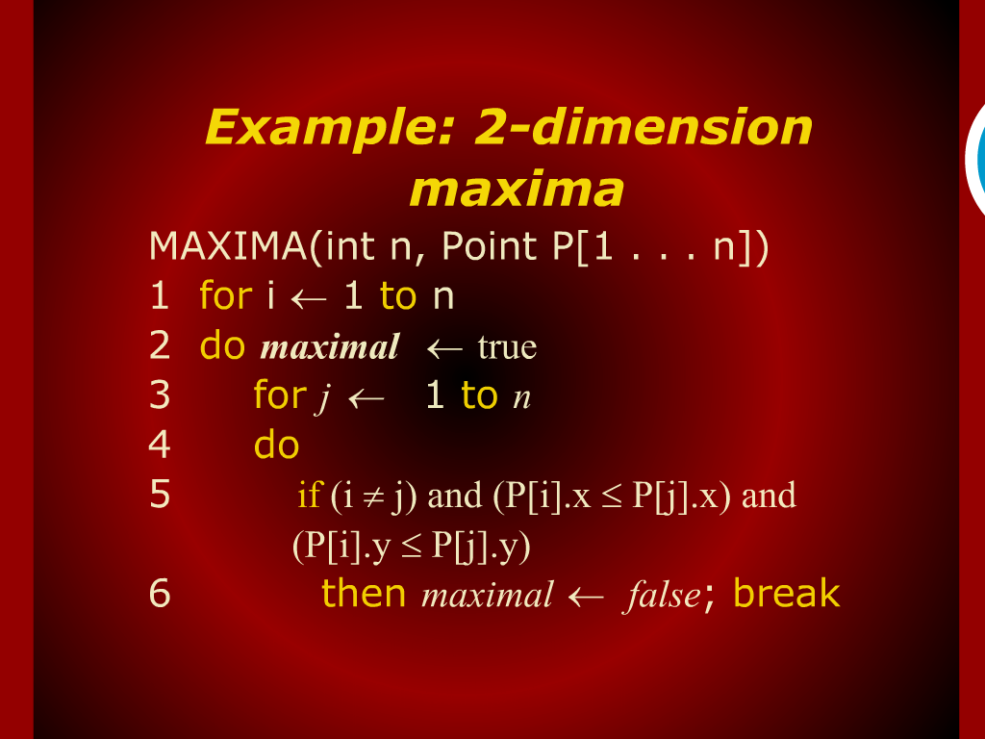
Example: 2-dimension maxima

Slide 10
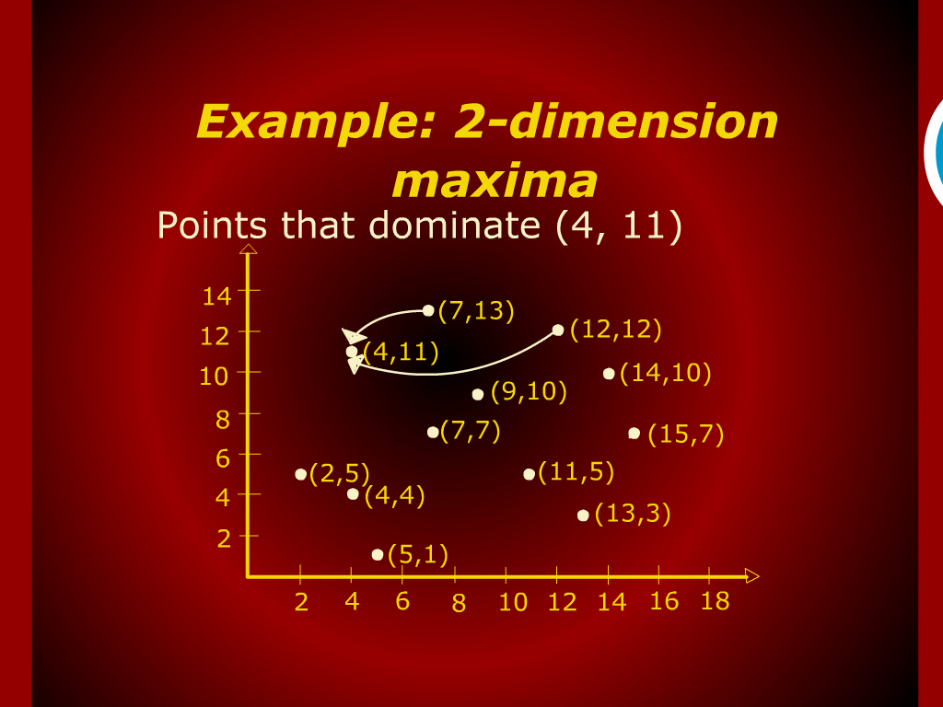
Example: 2-dimension maxima

Slide 11
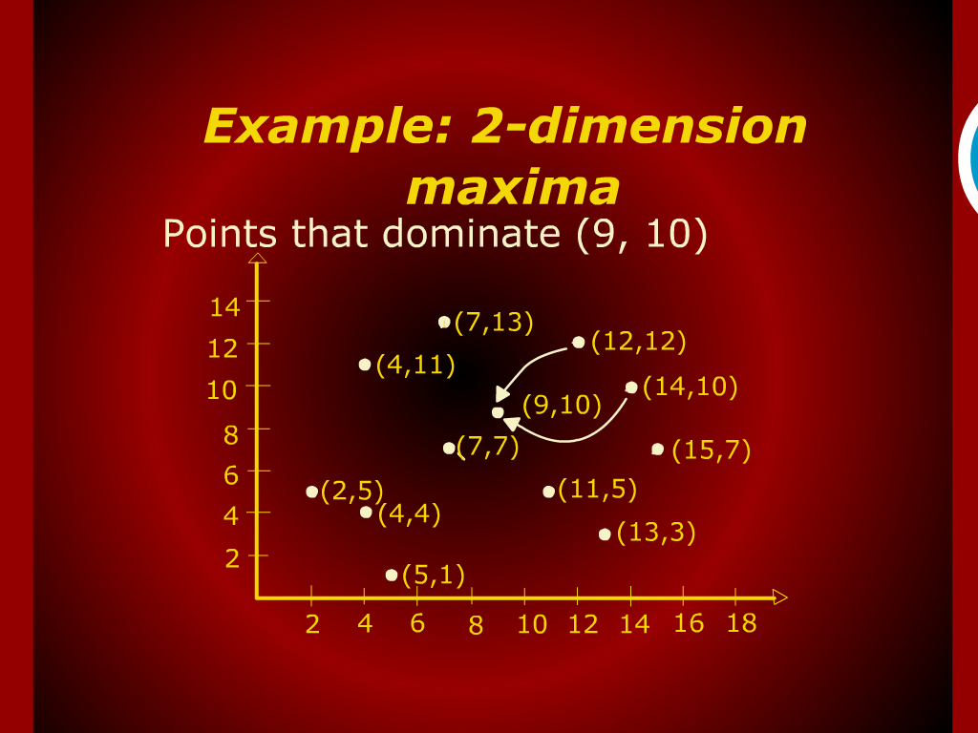
Example: 2-dimension maxima

Slide 12
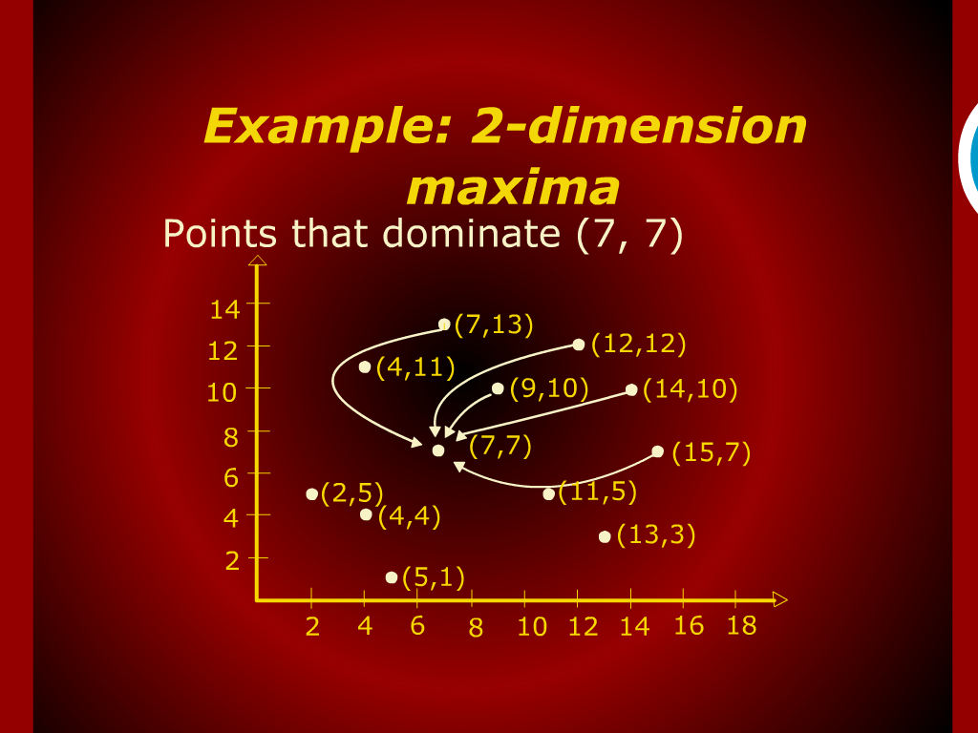
Example: 2-dimension maxima

Slide 13
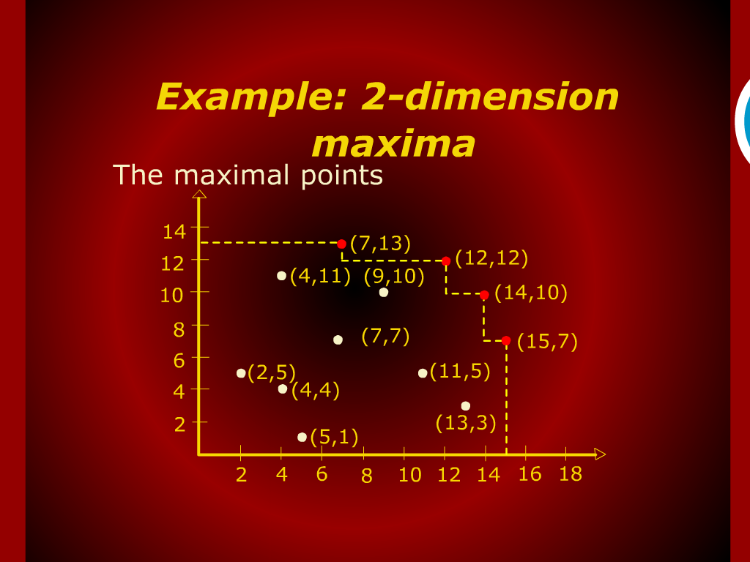
Example: 2-dimension maxima

Slide 14
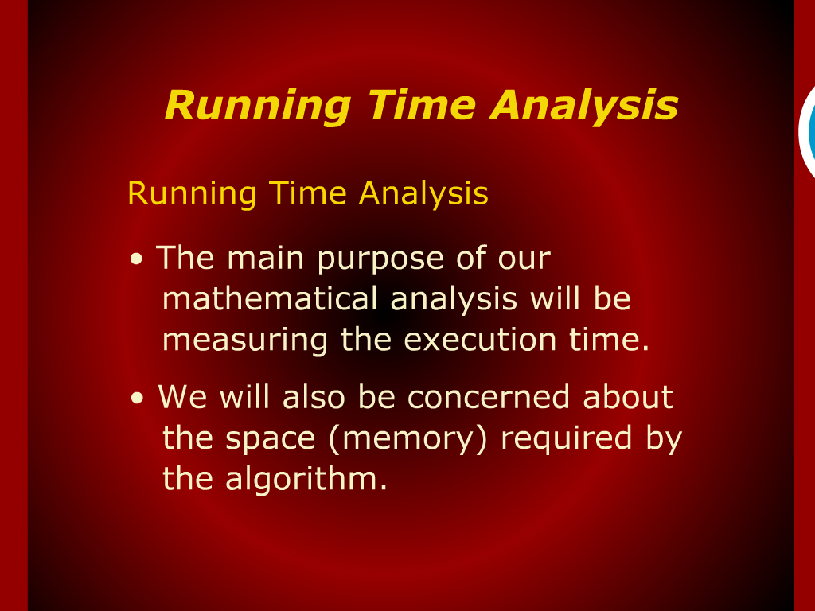
Running Time Analysis

Slide 15
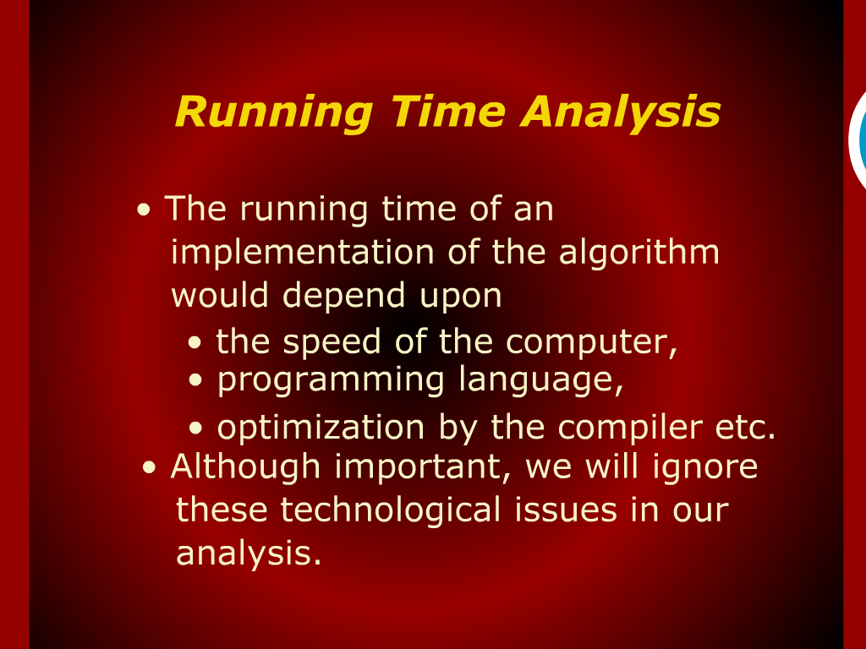
Running Time Analysis

Slide 16
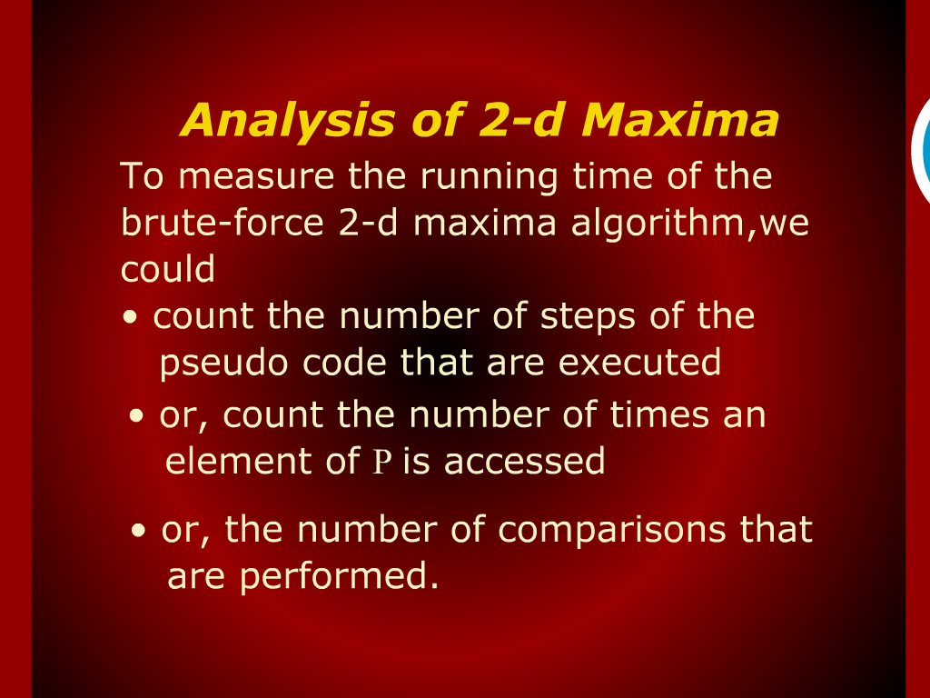
Analysis of 2-d Maixma

Slide 17
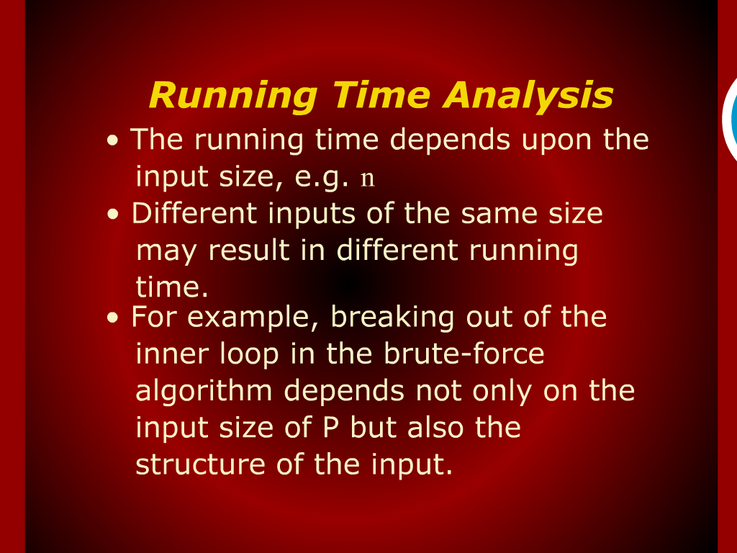
Running Time Analysis

Slide 18
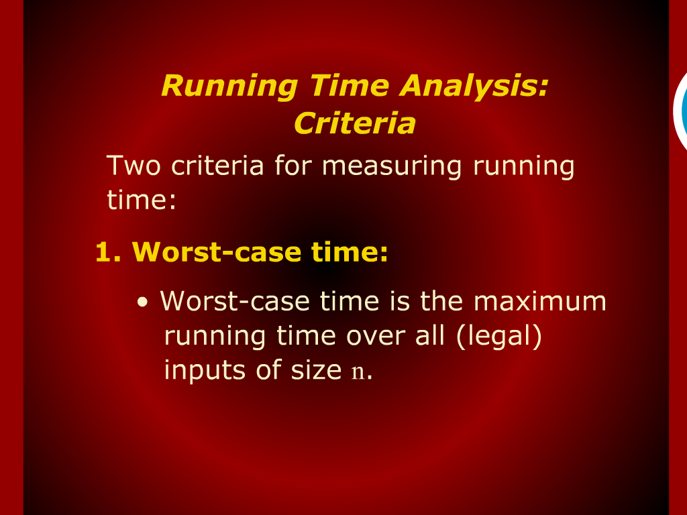
Running Time Analysis: Criteria

Slide 19
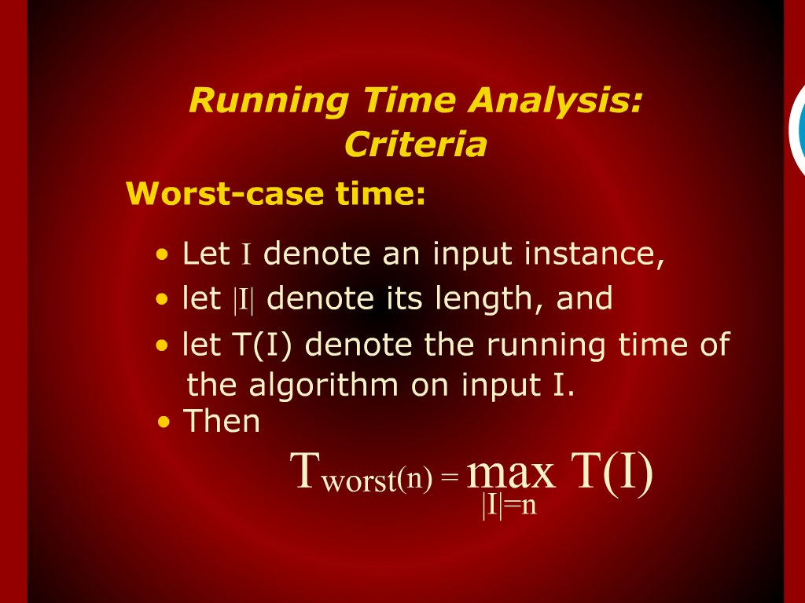
Running Time Analysis: Criteria

Slide 20
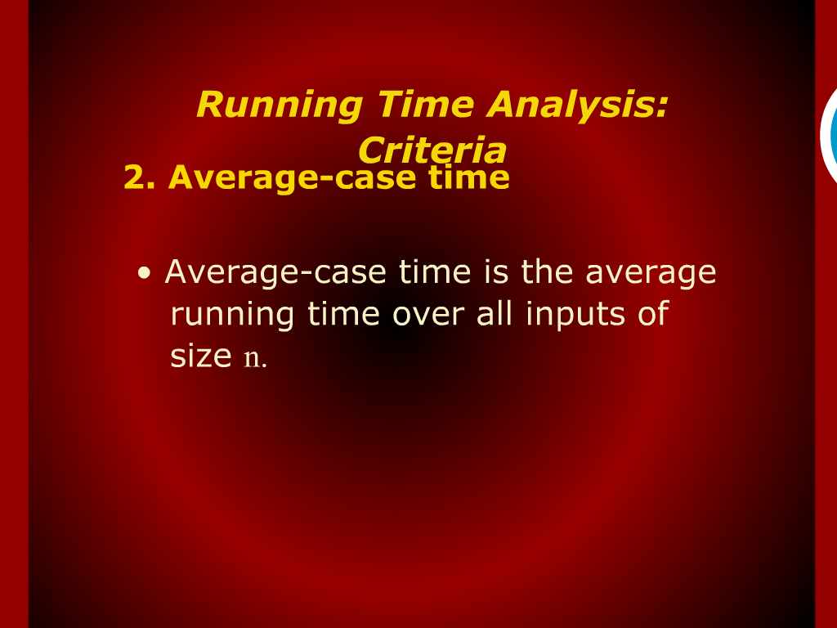
Running Time Analysis: Criteria

Slide 21
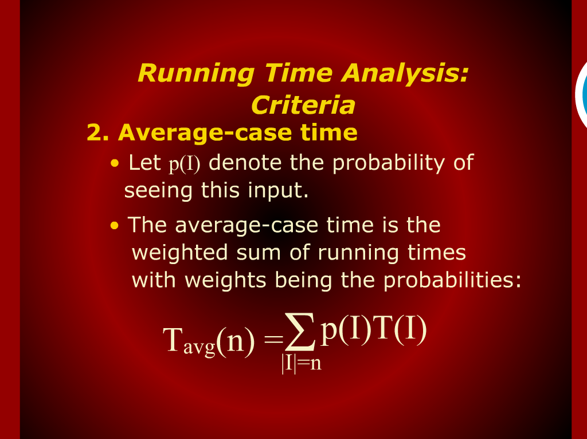
Running Time Analysis: Criteria

Slide 22
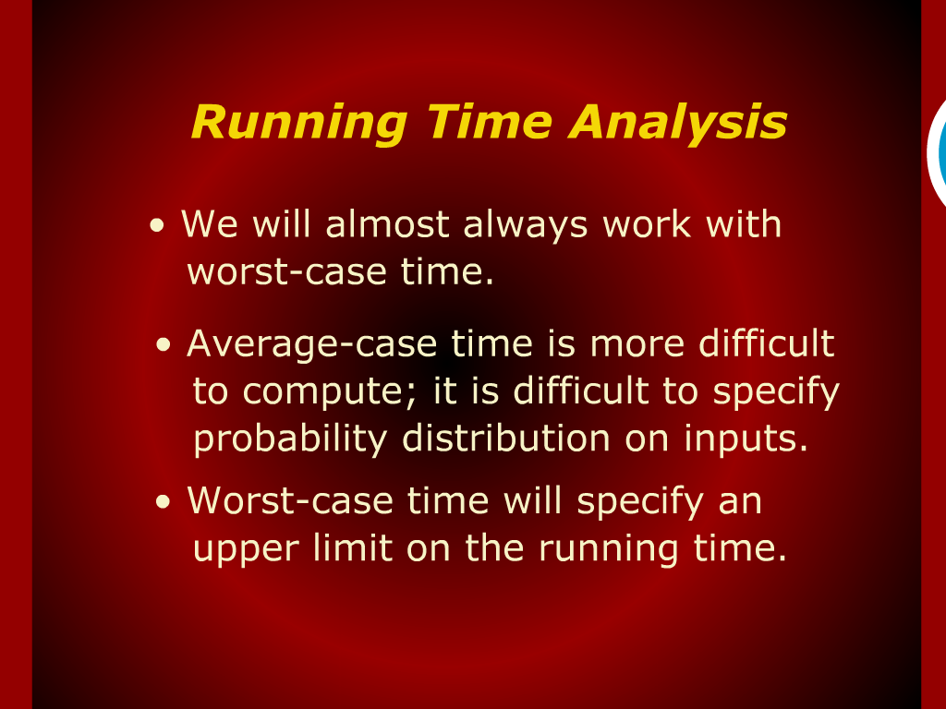
Running Time Analysis

Slide 23
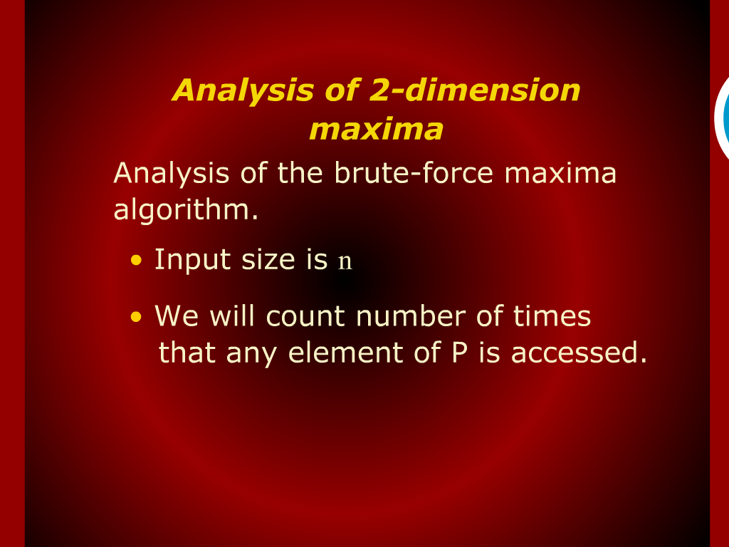
Analysis of 2-dimension maxima

Slide 24
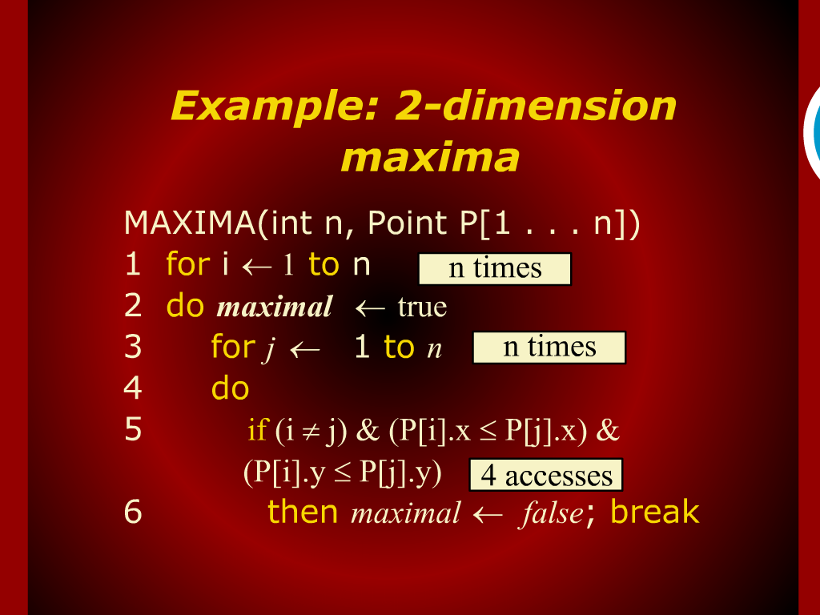
Analysis of 2-dimension maxima

Slide 25
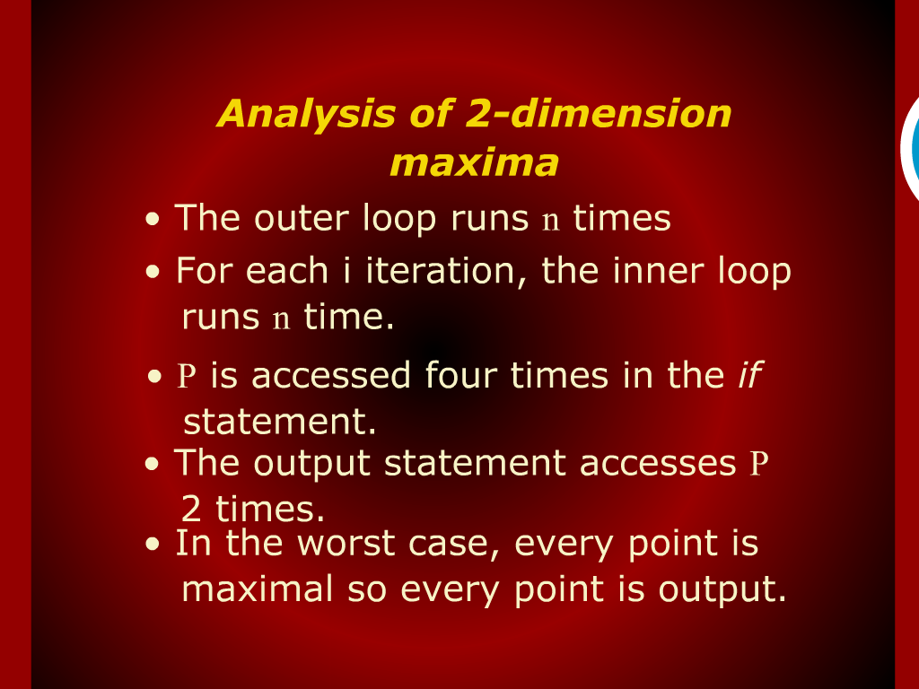
Analysis of 2-dimension maxima

Slide 26
